Slide 1
PROJECT MID-TERM DEFFENCE ON [SUDOKU GAME (ALPHABETICAL)]
PRESENTED BY:
PRAZWOL BISHTA
BIBEK POUDEL
RIKESH LAMA GOLEY
HARI NARAYAN CHAUDHARY

Slide 2
INTRODUCTION
1.1 Background
The history of Sudoku dates back to an 18th Century Swiss mathematician’s game called “Latin Squares”
The game first appeared in Japan in 1984 where it was given the name “Sudoku,”
It was later improved in the modern era and given the name Wordoku when it took on an alphabetical format.

Slide 3
1.2 Problem Statement
Most of us struggle with the question of how to pass the time while we're idle.
1.3 Objectives
The main goal is to make one of the existing sudoku-making techniques (ALPHABETICAL)

Slide 4
1.4 Project Features
Accessible from everywhere if device is provided
Hints are available to make it little easier
1.5.1 Economic Feasibility
There is minimum cost assumed is done based on our ideas and online resources

Slide 5
1.5.2 Technical Feasibility
Works on every computer
1.5.3 Time Feasibility
Time expected for the completion of this project will be 2 to 3 weeks now
1.6 SYSTEM REQUIREMENT
1.6.1 Software Requirement
MinGW compiler or any other
Any IDE software
1.6.2 Hardware Requirement
Any computer device

Slide 6
LITERATURE REVIEW
The first project we reviewed was of Tarun Kumar from “Ims Engineering College, Gaziabaad”
he performed sudoku project in java swing
He used Java swing and code blocks to create the project
This project included features like scope of project, Solving methods etc

Slide 7
Continue…
We also reviewed another project done by Gokul das
In that Project he created soduko game using C#.
The Application starts with a nice looking splash form which leads to a Matrix sudoku table
Its was consists that rules of sudoku, Good Graphical presentation, Auto check the inserted value is correct or not, Auto generation of sudoku table etc

Slide 8
Continue…
Many of the projects that we reviewed contained features like Generating automatic sudoku table, auto check the correct value, good graphics etc
They used their own header file externally
we decided to combine this feature in our game Wordoku
As we know making of Worduko game with the reference of sudoku is crucial thing
With these features everyone can play this game with different variant like number as well as alphabetical so they won’t get bored easily
This game is paperless and it reduces the limitation different sudoku table which required time

Slide 9
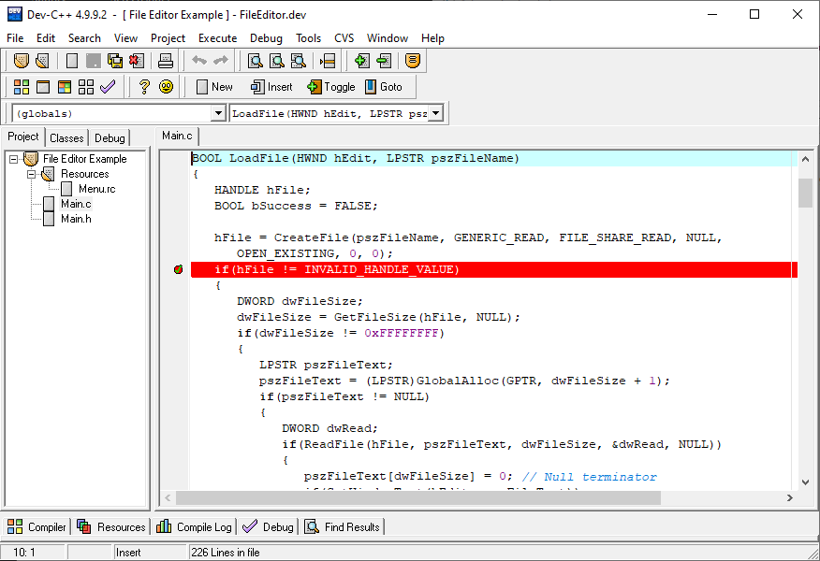
METHODOLOGY
We have used Dev-C++ IDE for development
Dev-C++ is a full-featured C and C++ Integrated Development Environment (IDE) for Windows platforms
Fig: Dev-c++

Slide 10
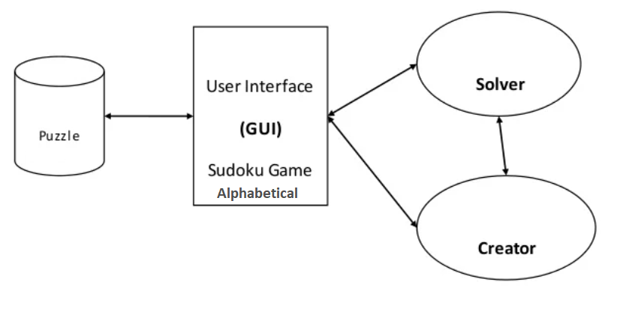
Hardware and software requirement
C programming language is used
Dev-c++ IDE is used
Proposed project block diagram
Fig: Block diagram of Wordoku

Slide 11
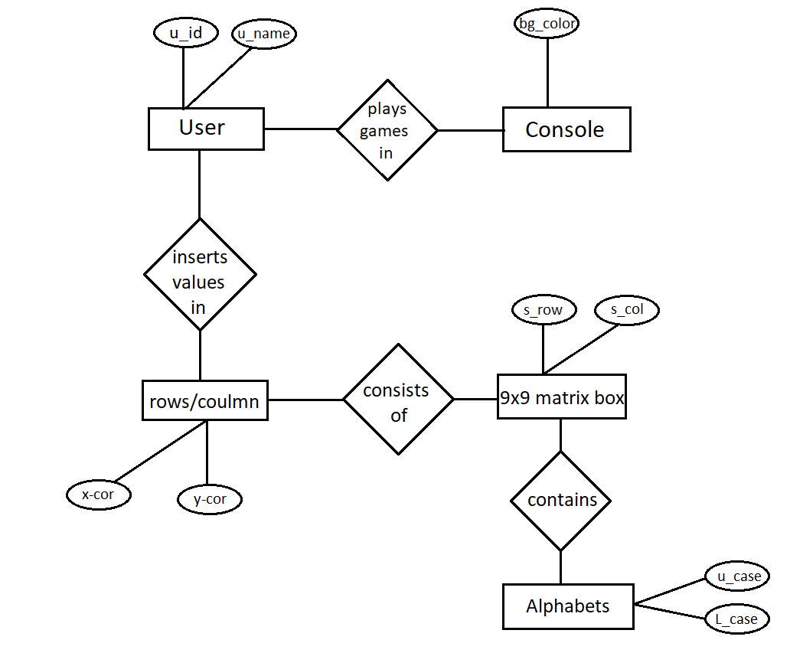
Entity-relationship model

Slide 12
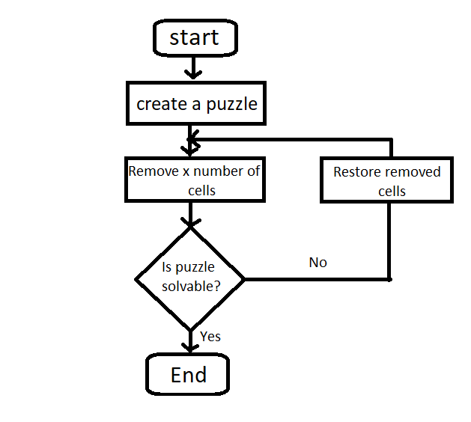
Working principle (flowchart)

Slide 13
WORK DONE AND REMAINING WORK
Work Done
Matrix Wordoku Table
Check availability in row and column
Remaining Work
Making matrix wordoku table well organized
Check availability in grid and make it repeat this process

Slide 14
Scheduled
We have scheduled our project to complete it within 3 weeks.
Little logic portion is remains to get completed
Till now we haven’t faced any big problem in our program
Work is expected to be completed within the end of October

Slide 15
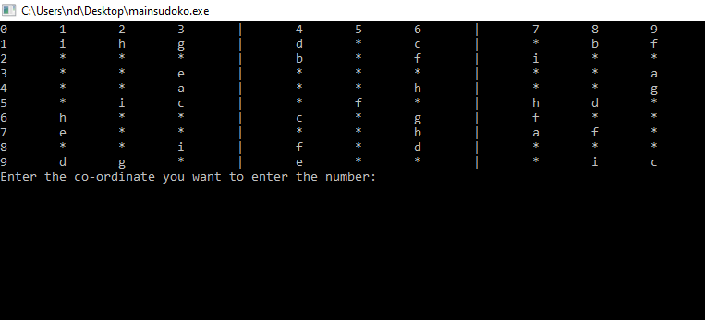
APPENDICES
We have the output of wordoku as shown below:

Slide 16
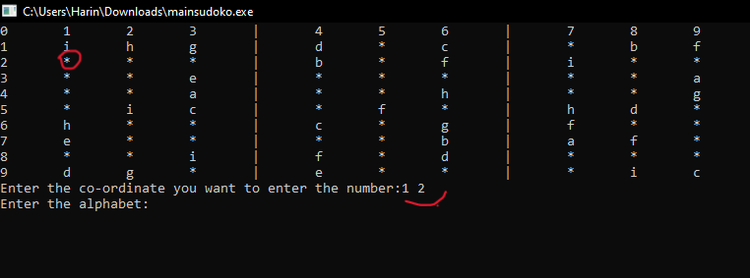
Selecting positon to insert

Slide 17
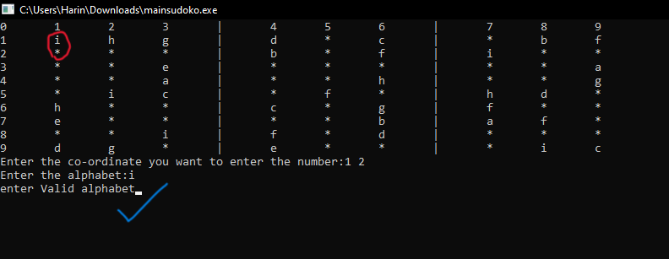
Inserting invalid value

Slide 18
Thankyou !!

